Slide 1
LECTURE 1:
DEFINITION OF OPTIMISATION
Big Data and Analytics Summer School : The Synergy of Optimisation and Machine Learning
Daniel Karapetyan – daniel.karapetyan@nottingham.ac.uk 2022

Slide 2

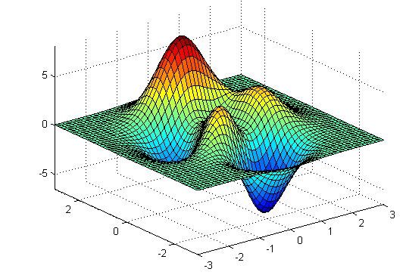


What is optimisation?
minimise f(x), where x is a vector and f(x) is the objective
function.
Two dimensions
One dimension
f(x)
f(x,y)
x
x
y
Image source:
https://www.iei.liu.se/machine/courses/TMKT48?l=en

Slide 3


Minimisation vs Maximisation
minimise f(x) equivalent to maximise –f(x)
f(x)
-f(x)
x
x
Minimisation of f(x) finds the minimum
Minimisation of –f(x) finds the maximum

Slide 4
Why is optimisation difficult?
f(x)

Slide 5
Why is optimisation difficult?
f(x)

Slide 6



Why is optimisation difficult?
For computer, where is the minimum? You can randomly explore point son the line,,,,,
f(x)

Slide 7

Why is optimisation difficult?
f(x)

Slide 8
Why is optimisation difficult?
… eventually you will fill all points on the curve and find the minimum, but is not very efficient … but goes to show how difficult this is for a computer
f(x)

Slide 9
Real-world optimisation
Previous example: one decision variable (x) = one dimensional
Real world: usually multiple decision variables
Objective function f(x) is usually a complex function, e.g.
the length of a path in the shortest path problem
the accuracy of a classifier
Question: can you think of any real-world optimisation problems?

